Slide 1

Post Award
Vendor’s Conference
U.S. Probation Office
U.S. Pretrial Services Office
October 13, 2022

Slide 2
Welcome!
Nicholas Macker, Supervisory U.S. Probation Officer
Tracy Zacchigna, Supervisory U.S. Probation Officer
Robert Zamarelli, Senior U.S. Probation Officer/Contracting Officer
Patrick May, Supervisory U.S. Pretrial Services Officer
Brian Kolbus, Supervisory U.S. Pretrial Services Office
Ernesto De La Rosa, U.S. Pretrial Services Office Laboratory Technician
NDIL U.S. Pretrial and Probation Offices Treatment Services Team

Slide 3

Agenda
Review of Blanket Purchase Agreement (BPA) & Statement of Work (SOW)
Clinical Services
Evidence Based Practices / Role of Officer
Local Needs
Monitoring Reports
SPCS for Billing Purposes
Invoicing
File Preparation & Maintenance
Ordering of Supplies
U/A Collection

Slide 4
Pursuant to Title 18 U.S.C. Section 3672 –
Duties of Director of Administrative Office of the U.S. Courts
“He shall contract with any appropriate public or private agency or person for the detection of and care in the community of an offender who is an alcohol-dependent person, an addict, or a drug-dependent person... This authority shall include the authority to provide... medical, educational, social, psychological and vocation services; corrective and preventative guidance and training; and other rehabilitative services designed to protect the public and benefit the alcohol-dependent person, addict, or drug dependent person ... by controlling his dependence and his susceptibility to addiction... He may negotiate and award such contracts without regard to section 3709 of the revised Statutes of United States.”

Slide 5
BPA/NCPO and Statement of Work
(“Section C” of BPA, Will be on Website)
BPA vs. NCPO
U.S. Probation and Pretrial Services Offices are required to ensure that all vendors adhere to the specifications of the Statement of Work, Section C of the Blanket Purchase Agreement
We must maintain control of services requested/provided (in consultation with the provider)
Ongoing vendor monitoring (monitoring reports will be discussed later)
Please READ the Statement of Work, you will find the answers to the vast majority of questions are within that document

Slide 6
The Initial Referral Process
Prob 45 with signatures (referral agent signature must be there to render service(s) and ne paid for services)
ROIs (SU Prob 11B, MH Prob 11I)
Treatment Referral Worksheet (in most cases)
PCRA Interpretation Report (in most cases)
Any changes in treatment services received will require an Amended Prob 45, and cessation of services requires a Termination Prob 45
An updated PCRA interpretation report will be sent when any changes in risk level or dynamic risk factors occurs

Slide 8

Substance Abuse Services
1010 Urine Collection and Reporting: The vendor shall perform the procedures related to the collection, testing and reporting of urine specimens.
2011 Substance Abuse Intake Assessment Report: Comprehensive biopsychosocial intake assessment and report conducted by a state certified addictions counselor or licensed clinician. The assessor shall identify the defendant(s)/offender(s) substance abuse severity, strengths, weaknesses, and readiness for treatment.
2020 Clinical Cognitive Behavioral Group: 2 to 12 defendants/offenders led by a trained and certified counselor as defined in SOW. Treatment shall include the use of cognitive and behavioral techniques to change defendant/offender thought patterns while teaching pro-social skill building.
2010 Individual Substance Abuse Counseling Clinical interaction between defendant/offender and a trained and certified counselor. The interactions are deliberate and based on various clinical modalities, which have demonstrated evidence to change behavior.
2030 Family Counseling: Defendant/offender and one or more family members. The vendor may meet with family members without the offender present with USPO/USPSO approval.
2001 Short Term Residential: Facilities provide a highly structured environment that incorporates counseling, drug testing, and other approaches that involve cooperative living for people receiving treatment. Must have 6 hours of structured programs per day (3 of those must be clinical group).

Slide 9

Substance Abuse Cont’d.
8090 Non-Medical Detoxification: In a non-medical therapeutic “social detoxification” setting with routine medical and nursing services on call.
4010 Medical Exam (only used in conjunction with methadone maintenance program): Per defendant/offender, as deemed medically necessary, conducted by a licensed medical doctor/physician, or other qualified practitioner.
4020 Laboratory Studies and Report: Including blood and urine testing at actual price when deemed medically necessary.
7021 Administration Fee Agonist/Antagonist Medication : to acquire the agonist/antagonist medication (i.e. via pharmacy or other source), not exceeding 5% of the actual funds expended for the medication.
9020 Methadone Maintenance Treatment: Requires the vendor to administer methadone to a defendant/offender for a period of time longer than 90 days.
7020 Agonist/Antagonist Medication: in either oral or injectable form subsequent to a prescription from a licensed psychiatrist, medical doctor/physician, or other qualified practitioner with current prescriptive authority, who meets the standards or practice established by his/her state’s regulatory board. (Naltrexone, Trexan, Antabuse, Methadone, Buprenorphine, etc.) In addition to the prescription of either oral or injectable agonist/antagonist medication, the vendor is authorized to prescribe withdrawal assistance medication to assist the client during the withdrawal process. Reimbursement for the prescriptions that fall outside this realm is not authorized. The USPO/USPSO should generally authorize this in conjunction with individual or group counseling (project codes 2010, 2022, 2022, 2030, 2040, 2090, 6015, 6026, 6027, 6036)

Slide 10

Mental Health Services
5011 Mental Health Assessment: Performed by a masters or doctoral level clinician who is licensed or certified and meets the standards of practice established by his/her state regulatory board.
5030 Psychiatric Evaluation and Report: To establish a psychiatric diagnosis, to determine the need for psychotropic medications and/or to develop an initial treatment plan with particular consideration of any immediate interventions that may be needed to ensure the defendant’s/offender’s safety and that of the community.
6000 Case Management Services (Mental Health): A method of coordinating the care of severely mentally ill people in the community. Case management services serve as a way of linking clients to essential services including, but not limited to, securing financial benefits, health and mental health care. Only to be used in conjunction with mental health counseling.
6010 Mental Health Counseling (Individual): Clinical interaction between a defendant/offender and a psychiatrist, psychologist, or masters or doctoral level practitioner who is licensed or certified by his/her state’s regulatory board. The interactions shall be deliberate and based on clinical modalities, which have demonstrated evidence to stabilize mental health symptoms.

Slide 11
Mental Health Cont’d.
6030 Mental Health Counseling (Family): Defendant/offender and one or more family members. The vendor may meet with family members without the defendant/offender present with USPO/USPSO written approval.
6051 Medication Monitoring: Prescribe and evaluate the efficacy of psychotropic medications (incorporating feedback from the treatment provider and/or the USPO/USPSO).
6001 Short Term Residential for Co-Occurring Disorders: Inpatient treatment program for individuals who are suffering from both chemical abuse/dependence and a mental health disorder
6016 Integrated Treatment Services for Co-Occurring Disorders Assessment: This is a comprehensive biopsychosocial assessment and report which shall be performed by a masters or doctoral level clinician who is licensed or certified and meets the standards of practice established by his/her state regulatory board for the purposes of defining the nature of the problem and developing specific treatment recommendations addressing the problem. The assessment could also be conducted by a non-licensed masters level clinician under the supervision of a licensed professional in accordance with state licensing standards.
6015 Integrated Treatment Services for Co-Occurring Disorders/Individual Counseling: To one defendant/offender. This treatment shall conform to the standards set forth in 2010 and 6010 but shall be completed in an integrated fashion.
6026 Group Counseling-Integrated Treatment for Co-Occurring Disorders: 2 to 10 defendants/offenders. Treatment shall conform to the standards set forth in 2020 (substance abuse) and 6020 (mental health), but shall be completed in an integrated fashion

Slide 12
Sex Offense Specific Services
5012 Sex Offense Specific Evaluation and Report: Commonly known as a “psychosexual evaluation,” is a comprehensive evaluation of an alleged or convicted sex offender, meant to provide a written clinical evaluation of a defendant’s/offender's risk for reoffending and current amenability for treatment; to guide and direct specific recommendations for the conditions of treatment and supervision; to provide information that will help to identify the optimal setting, intensity of intervention, and level of supervision; and to assess the potential dangerousness of the defendant/offender.
5022 Clinical Polygraph Exam and Report: Diagnostic instrument and procedure which includes a report designed to assist in the treatment and supervision of defendants/offenders by detecting deception or verifying the truth of their statements.
5023 Maintenance/Monitoring Test: Employed to periodically investigate the defendant/offender’s honesty with community supervision and compliance with supervision.
5025 VRT Measure of Sexual Interest: An objective method for evaluating sexual interest which is designed to determine sex offender treatment needs and risk levels.

Slide 13
Sex Offense Services Cont’d.
6012 Individual SO Treatment: Treatment is provided by a licensed/certified psychiatrist, psychologist, or masters or doctoral level practitioners who meets the standards of practice established by his/her state’s regulatory board and adheres to the established ethics, standards of practices of state sex offender management board. Practitioners employ treatment methods that are based on a recognition of the long-term, comprehensive, offense-specific treatment for sex offenders.
7013 Individualized Specialized Treatment (Sex Offender-Pretrial Only).
6090 Group Sex Offense-Specific Treatment Readiness: 2 to 12 defendants/offenders. Treatment Readiness Group shall include offenders with little or no understanding of the cycle of sexual offenses. The attendance of one family member per offender shall be included in the unit price in Section B.
6091 Sex Offender and Chaperone Training and Support: A psycho-educational/specialized training for one or more significant others, or family members of a defendant/offender charged with or convicted of a sex offense. Goal is to provide a means of certifying individuals designated by the USPO/USPSO to act as a chaperone for the defendant/offender and safeguard for the community.

Slide 14
Sex Offense Services Cont’d.
6022 Group SO Treatment: 2 to 10 defendants/offenders. Treatment is provided by a licensed/certified psychiatrist, psychologist, or masters or doctoral level practitioners who meets the standards of practice established by his/her state’s regulatory board and adheres to the established ethics, standards of practices of state sex offender management board. Practitioners employ treatment methods that are based on a recognition of the long-term, comprehensive, offense-specific treatment for sex offenders.
7023 Group Specialized Treatment (Sex Offender-Pretrial Only): 2 to 10 defendants.
6032 Family SO Treatment: To a defendant/offender and one or more family members. Treatment is provided by a licensed/certified psychiatrist, psychologist, or masters or doctoral level practitioners who meets the standards of practice established by his/her state’s regulatory board and adheres to the established ethics, standards of practices of state sex offender management board. Practitioners employ treatment methods that are based on a recognition of the long-term, comprehensive, offense-specific treatment for sex offenders.

Slide 15
Other Services
1201 Administrative Fee For Defendant/Offender Transportation Expenses: A reasonable monthly fee to administer transportation expense funds, not exceed 5% of the monthly funds distributed under 1202.
1202 Defendant/Offender Transportation Expenses: For defendant/offender transportation to and from treatment facilities.
1501 Defendant/Offender Reimbursement and Co-Payment: Collect any co-payment authorized on the Program Plan (Probation Form 45) and deduct any collected co-payment from the next invoice to be submitted to the judiciary.
Additional details regarding each project code can be found in Section C of the Statement of Work (SOW), available under the treatment services tab of our website.
*Note several “Local Needs” will be posted, detailing service specifications in some areas beyond those found in the SOW*

Slide 16
Vendor Staff Requirements
SUBSTANCE ABUSE
Undergo training on proper urinalysis collection and administration procedures.
Assessments and Counseling will be face to face and conducted by a state certified addictions counselor or clinician who meets the standards of practice established by his/her state’s regulatory board.
Counselors will have at least one of the following:
  Advanced degree (masters or doctoral level) in behavioral science, preferably psychology or social work
  A BA/BS and at least 2 years of drug treatment training and/or experience
  Counselors shall be certified and/or have credentials to engage in substance abuse treatment interventions per state regulatory board/accrediting agency
  Paraprofessionals can be used only under the supervision of and in conjunction with, a staff member described above, and after approval is given from Contracting Officer. Interns may be considered paraprofessionals.
  Emergency services (after hour staff phone numbers/local hotlines and/or procedures when counselors are unavailable

Slide 17
Vendor Staff Requirements
Mental Health & Co-occurring
  Counseling: Must be a licensed/certified psychiatrist, psychologist, masters or doctorate-level practitioner who meets standards of their state regulatory board
  Psychological Evaluations/Testing: Licensed/certified psychologist (PHD or Psy.D, or other advanced doctoral degree meeting standards of state’s regulatory board
  Psychiatric Evaluations/Testing: Licensed medical doctor/physician, a psychiatrist who specializes in disorders of the mind, is board certified or board-eligible and meets standards of practice established by the state regulatory board.
  Medication Monitoring: Licensed psychiatrist, medical doctor or physician with prescriptive authority, who is board certified or board-eligible and meets standards of practice established by the state regulatory board.
  Case Management Services: Bachelors in behavioral health, HS Diploma or GED with 5 years experience in BH setting, work under direct supervision of a licensed/certified psychiatrist/psychologist, or masters or doctorate-level practitioner who meets standards established by state regulatory board
  Emergency Services (after hour staff phone numbers/local hotlines and/or procedures when counselors are unavailable).

Slide 18
Vendor Staff Requirements
Sex Offense Specific
Evaluations/Treatment/Chaperone Training and Support Services: Are conducted by a licensed/certified psychiatrist, psychologist, or masters or doctorate-level practitioner who meets state regulatory and sex offender management boards and adhere to the Code of Ethics and Practice Standards and Guidelines published by ATSA
  VRT (Abel): conducted by trained examiner and adhere to ATSA standards
  Polygraph Examinations:
    Education: Examiners must be graduates of poly school accredited by American Poly Assoc; minimum baccalaureate or higher from a regionally accredited univ or college, or have at least 5 years experience as a full time commissioned federal, state or municipal LEO; min. 40 hours of post- conviction sex offender testing (PCSOT) specialized instruction. Examiners who passed a final exam approved by the APA are preferred
    Certification: Examiners shall be members of a professional organization that provides regular training on research and management of SO
    Experience: Min. of 2 years of poly experience in criminal cases. Specialized training or experience with sex offenders
    Ethics and Standards: Adhere to ethics and standards of APA
Licensure: Licensed by state’s regulatory board

Slide 19
Residential Treatment
Staff Requirements
  Adequately trained and physically able staff and 24/7 coverage
  Use volunteers only at direction of USPO
  Keep written position descriptions that accurately describe current duties for all staff performing services under this agreement
  One staff member each shift trained in CPR and first aid
  Code Compliance
  Sleeping and Bathroom Facilities
  Emergency Plans
  Safety Precautions

Slide 20
Facility Requirements
Adequate access for clients with physical disabilities
  Comply with all applicable state, federal and local laws and regulations when performing services under this contract

Slide 21
Vendor Staff Restrictions
Post-Award
  Vendors & Employees Shall:
  Avoid compromising relationships with def/off and UAPO/USPSO staff
  Not employ, contract with, or pay any def/off or def/off firm or business to do any work for vendor or its employees
  Report any improprieties to USPO or USPSO
  Report within 48 hours to USPO/USPSO, any investigations, pending charges, arrests, and/or restriction on licenses or certifications, whether imposed or voluntary, on any staff member
  Notify USPO or USPSO in writing of any staff changes and provide documentation of any required licensing, certification, experience and education requirements and changes thereof. The Vendor shall submit an Offeror’s Staff Qualifications form (Section L – Attachment C) for each new staff member added under this agreement
  Persons under supervision cannot perform services or have access to defendant/offender files
  If person charged or under investigation for a criminal offense, cannot perform services or have access to def/off files
  Persons convicted of a sexual offense cannot perform services or have access to def/off files
  Persons with restrictions on their license, certifications or practice, cannot perform services or have access to def/off files

Slide 22
Testimony and 3rd Party Disclosure
If a third party contacts the vendor for records, please contact the contracting officer
If a vendor receives a subpoenaed related to a probation or pretrial services client, please contact the contracting officer
Vendors shall not create, prepare, offer, or provide any opinions or reports, whether written or verbal that are not required by this SOW and the treatment program unless such action is approved in writing by the Chief U.S. Probation Officer or Chief U.S. Pretrial Services Officer

Slide 23
Evidence Based Practices
Interventions that research has demonstrated reduce offender risk and subsequent recidivism (commission of additional criminal acts) and therefore make a positive long-term contribution to public safety
Outcomes are also defined through practical realities (e.g., enhanced victim safety, improved clinical outcomes, reduction in recidivism, etc.)

Slide 24

Target Interventions
Risk Principle (who to target)
  Prioritize supervision and treatment services for higher risk offenders
Needs Principle (what to target)
  Interventions should target criminogenic needs (dynamic risk factors)
Responsivity Principle (how to target effectively)
  Interventions are most effective when they are based on research-supported models (general responsivity) AND
  are tailored to the unique characteristics of individual offenders (specific responsivity)
Dosage (how much)
  Hours of service delivered (by corrections professionals and treatment/interventions) should range from 100-300 hours for moderate to high risk offenders.
  It has also been suggested that officers should aim to structure 40-70% of high risk offenders’ time for 3-9 months.
  Quality of programming matters!!!!
Treatment Principle
  Integrate treatment into full sentence/sanction requirements

Slide 25

The “Big Six” Dynamic Risk Factors
Dynamic Risk Factors:
1) Anti-Social Values
2) Criminal Peers
3) Low Self-Control
4) Dysfunctional Family Ties
5) Criminal Personality
6) Substance Abuse
Eric Shepardson & Lina Bello, Bureau of Governmental Research 2001, www.bgr.umd.edu.

Slide 26
Post Conviction Risk Assessment Tool (PCRA)
Static Risk Factor (does not change):
Criminal History
Dynamic Risk Factors (also referred to as Criminogenic Needs):
Cognitions (including elevated criminal thinking styles)
Social Networks
Education/Employment
Drug/Alcohol Problem
Violence

Slide 27
Dynamic Risk Factors
(Why should we target these?)
Changing these factors changes the probability of recidivism
Provide the basis for developing a supervision and treatment plan
Effectively addressing factors can reduce risk (and thus revocation and re-arrest), improve offender outcomes and increase community safety

Slide 28
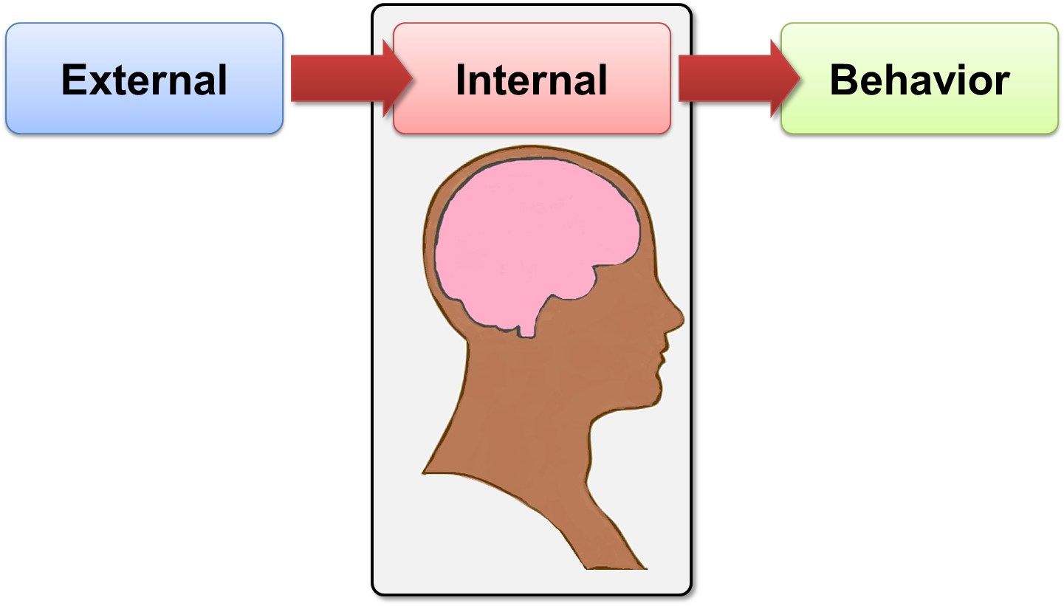
Cognitions are Key!!!
The Cognitive Model
“Thinking Controls Behavior”
Notes:
Talking Notes:
Explain the model.
There are external events that occur, internal thoughts we have about those external events, and then a behavior that occurs based on those thoughts.
The overall theme is “Thinking Controls Behavior”.
Slide Transition:
Let’s go a step farther.

Slide 29
PICTS (Offender Section)
Assessment of Criminal Thinking
General Criminal Thinking (GCT): This scale is an overall measure of criminal thinking and is the single best predictor on the Offender Self-Assessment.
Proactive Criminal Thinking: Identifies Individuals for whom crime is generally goal-directed and deliberate. Offenders who are proactive tend to expect positive things to come from their criminal behavior (e.g., money, status, power).
Reactive Criminal Thinking: Identifies individuals for whom crime is generally more of a reaction to a situation than planned behavior. Behavior is impulsive.
Eight Elevated Criminal Thinking Styles….

Slide 30
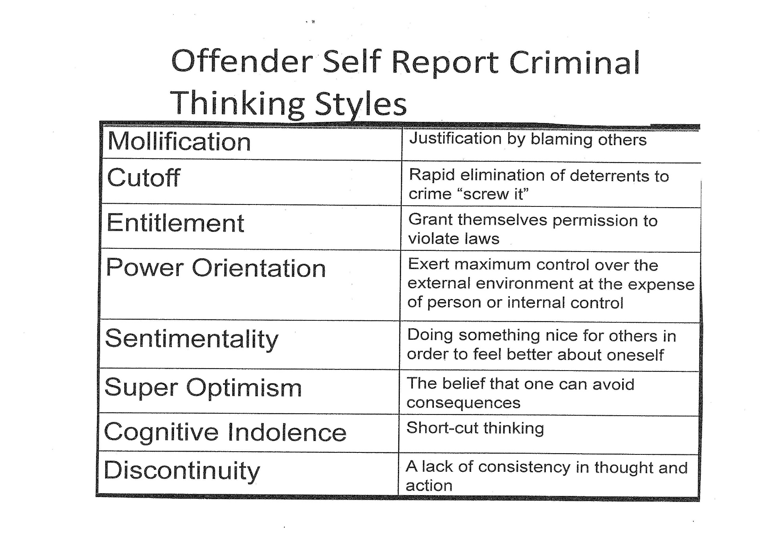

Slide 31
General Responsivity
CBT treatment modality utilized in individual and group counseling
Importance of “Treatment Matching”
Assessment of responsivity is important to maximize benefits of interventions/treatment
Interventions need to be tailored to meet that specific offender’s risk and needs
Offenders respond differently to treatment strategies

Slide 32
Specific Responsivity Factors
(Possible Barriers to Success)
Low intelligence
Physical handicap
Reading/writing problems
Mental health issues
No desire for change
Homeless
Transportation
Child care
Language
Ethnicity
History of abuse/neglect
Interpersonal anxiety

Slide 33
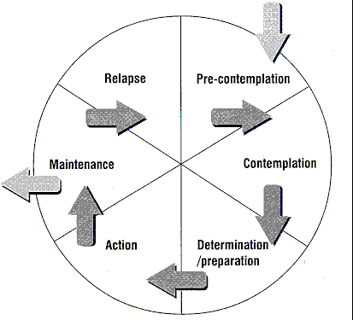
Stages of Change

Slide 34
Effective Interventions
Cognitive Behavioral Interventions/Therapy (CBI/T)
  Cognitions affect behavior and changes in thinking lead to changes in behavior (thinking impacts behavior)
  Directed toward changing dysfunctional or distorted thoughts
  Helps offender identify and manage/avoid high risk situations
  Teaches offenders tangible skills, such as problem solving
  Provides structured learning experiences
  **Homework, role plays, and practice are essential features of CBT
Notes:
Instructor:
Directions to Instructor (Information not to be shared):
Talking Notes:
Before we get into the specifics about its effectiveness, let’s just define CBT
Cognitive Behavioral Therapy (CBT) asserts that cognitions affect behavior and changes in thinking lead to changes in behavior (thinking impacts behavior)
Use with criminal justice populations:
Directed toward changing dysfunctional or distorted thoughts
Helps offender identify and manage/avoid high risk situations
Teaches offenders tangible skills, such as problem solving
Provides structured learning experiences
Transition Notes (words to lead into next slide):

Slide 35
Vendor Expectations?
The intervention and the treatment plan must address presenting clinical issues as well as the client’s specific criminogenic needs (a.k.a., dynamic risk factors), such as Cognitions, Drugs/Alcohol, Social Networks, Education/Employment
CBT is the required treatment modality
As to UA collection, a distinction needs to be made between a failure to appear and a “stall”
Vendors will be working collaboratively with the client’s probation officer
Vendor’s goals/focus should align with officer’s/client’s

Slide 36
What can you expect from the probation officer?
Client’s risk assessment results
Identification of client’s protective factors/strengths
Collateral contacts, including prosocial supports
Three-way meetings (vendor, client, PO)
Ongoing communication about issues/concerns and progress
Probation officers will be utilizing evidence-based interventions that will complement treatment (STARR skills, cognitive restructuring, Interactive Journaling, CBT groups)
Transition from Treatment/Discharge Planning

Slide 37
Local Needs
ALL Project Codes:
The district is including this local need as a means of addressing unique treatment barriers and needs in the district. On a case-by-case basis, telemedicine may be authorized to achieve these ends. The use of telemedicine is authorized only after the vendor and the USPO/USPSO staff the individual client’s case, determine he/she is appropriate for treatment via telemedicine, determine which specific services are appropriate via telemedicine, and it is approved by the district’s contracting officer or designee.
NOTE: The use of telemedicine is for the benefit of the Judiciary and not the convenience of the vendor. The use of telemedicine is not in lieu of the vendor’s ability to provide services in-person when appropriate. This requirement is not in lieu of the provisions which require the vendor (and any proposed subcontractor) to maintain an acceptable facility located within the defined catchment area.
The vendor is authorized to provide specified services via telemedicine, which includes providing health care delivery, assessment, diagnosis, consultation, and treatment and the transfer of medical data through interactive audio, video, or electronic/data communications. The vendor must adhere to and meet the same legal, ethical, and confidentiality standards when providing telemedicine. The vendor shall also obtain consent of the client before the delivery of telemedicine services and shall include documentation of the same in the individual’s treatment record.

Slide 38
ALL Project Codes (cont.)
In situations in which more than one client is in attendance, to ensure confidentiality for each session, the vendor shall require that each client verify that he or she is the only person on that line and that no person who is not part of that treatment group is listening. Each participant will also enter into a confidentiality agreement before being allowed to participate in treatment by telephone.
To verify that services were performed, the vendor shall complete the sign-in log with the following information:
• The client’s name.
• Date of the session.
• The time the session began and concluded.
• Confirmation of the means in which the session was conducted (i.e. teleconference, video conference, internet).
For de-escalation, if an emotionally charged topic was discussed or the client appears emotionally agitated, the vendor shall follow up with additional contact later in the day to ensure that the client has successfully de-escalated. The vendor shall also remind the client to reach out to his or her social support system at any time.

Slide 39
Local Needs Urine Collection
ONLY City CA 10 Project Code 1010: The urine collection program will be offered no fewer than 3 days per week for a minimum of 6 hours per day. In order to accommodate the clients’ work schedules, the vendor shall offer 3 collection hours available in the morning as well as 3 hours of collection available any time after 4pm and ending no later than 10pm. The dates of the urine collection are determined by the U.S. Probation Office through consultation with the vendor.
All Other Clinics Project Code 1010: The urine collection program will be offered no fewer than 2 days per week for a minimum of 6 hours per day. In order to accommodate the clients’ work schedules, the vendor shall offer 3 collection hours available in the morning as well as 3 hours of collection available any time after 4pm and ending no later than 10pm. The dates of the urine collection are determined by the U.S. Probation Office through consultation with the vendor.

Slide 40
Sex Offender Local Needs…
Project Codes 6012, 6022, 6032, 6090, 6091, 7013, 7023: Sex Offense Specific Individual and Group Counseling will be available a minimum of three days per week.
Project Codes 6012, 6022, 6032, 6090, 6091, 7013, 7023 The course materials deemed necessary for sex offense specific individual and group treatment (e.g. worksheets, workbooks) shall be provided by the vendor and included in the price for these services.

Slide 41
Documentation of Services
Monthly Treatment Logs
  Identify treatment goals
  Steps taken toward the goals
  Describe any set backs
  Identify ways the PO can help/support client over the next month
  Describe offender’s commitment to treatment
  Is ongoing treatment recommended
  Client’s overall progress

Slide 42
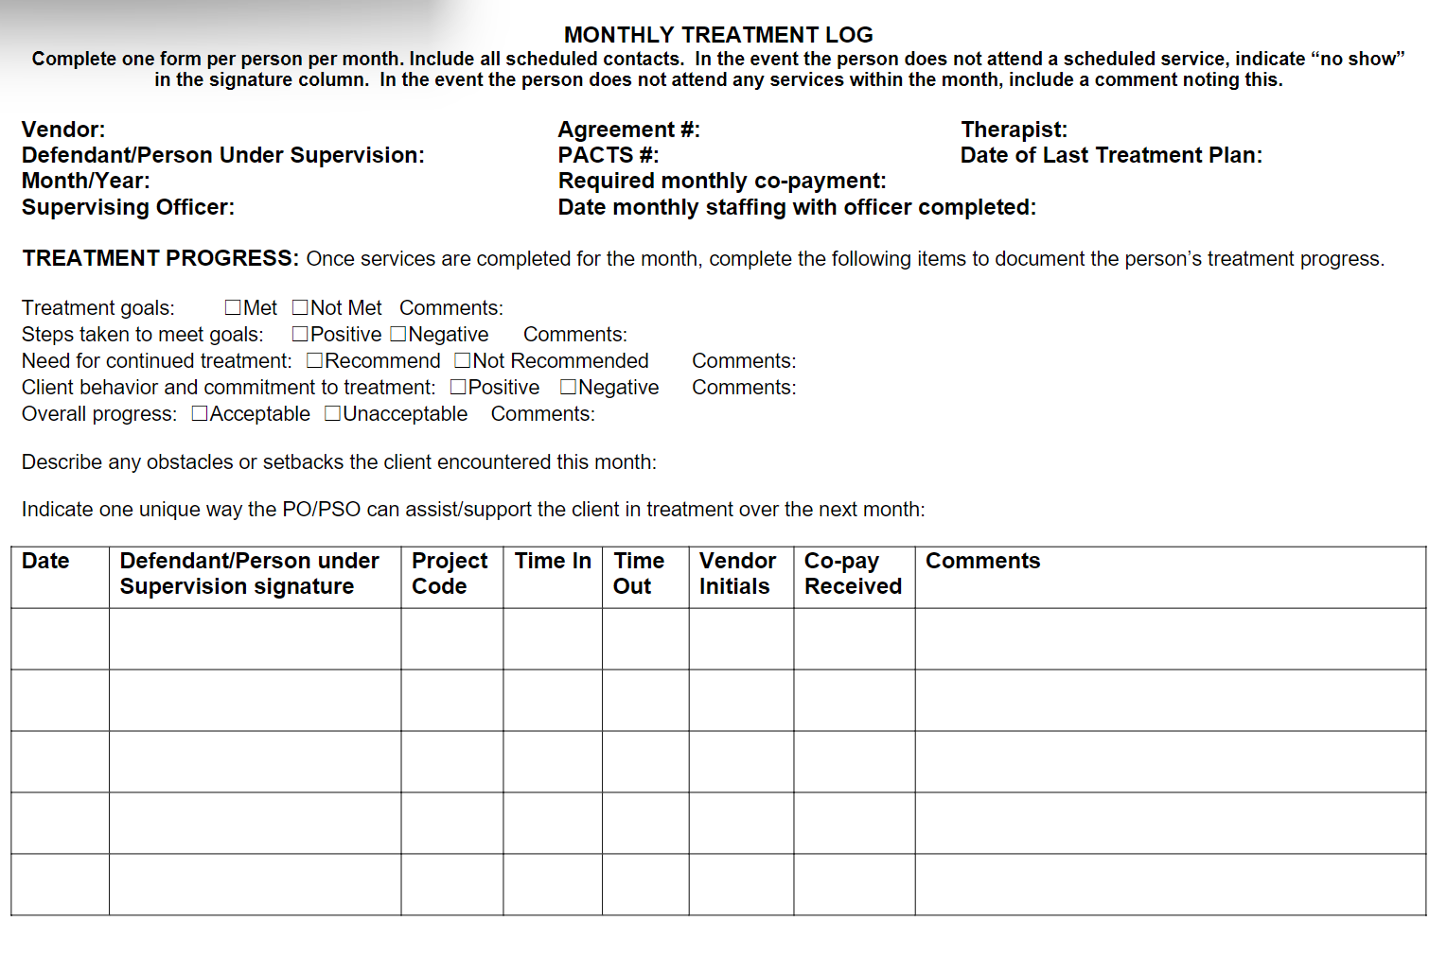

Slide 43
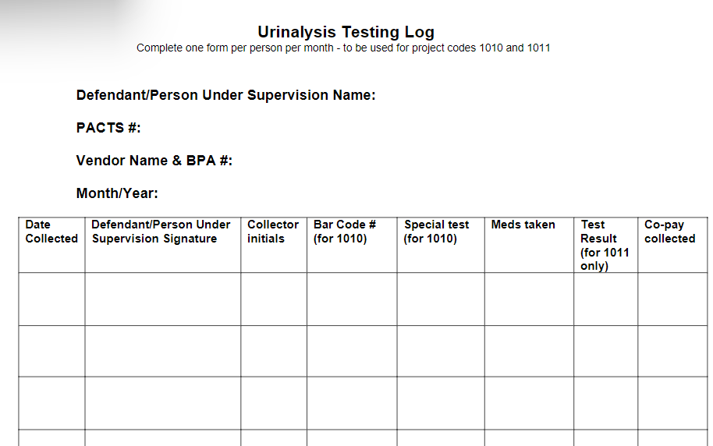

Slide 44
Additional Documentation of Services
Regular treatment staffings between the clinician and officer where there is an exchange of information and the communication is documented in both the agency and probation files
Documented 24 hour or less notification of any “no shows,” “stalls,”etc
Quarterly (90-day) Treatment Plans

Slide 45
Monitoring Requirements
Twice annually, One may be virtual
Review of file storage and maintenance
File review, including focus on quality of service and CBT interventions
Review of chain of custody and specimen storage for urinalysis collection
Are all contracted services being provided?

Slide 46
Working with Our Clients and the L12 Form
The completion of the L12 form and certifying that the employee(s) meet the education and employment requirements must be provided before an employee begins working with one of our clients.

Slide 47
Service Provider Communication System (SPCS)
The ERS Vendor Component and SPCS provides a secure communication protocol to vendors for billing purposes.
Communications with probation and pretrial officers can be conducted via the officer’s U.S. Courts email address. Whether this means of communication is sufficient for HIPAA compliance is a determination that only the vendor can make.
New vendors: More information as to SPCS and billing will be forthcoming.

Slide 48

Invoicing
Invoices AND associated documents must be submitted by the 10th of the month (late submissions will delay reimbursement)
Please include copies of any evaluations/assessments completed that month
Must provide updated treatment plans every 90-days (with billing)
Must provide ALL the services referenced on the Treatment Services Contract Program Plan (Prob 45)---or explanation as to why they weren’t provided (for services to be rendered all Prob 45s must have the referral agent’s signature; however, there should be 3 signatures on the Prob 45s, will not be back dated)
Do NOT provide services that are not ordered on Treatment Services Contract Program Plan (Prob 45)—you will not be reimbursed
Dates and project codes on billing invoice must match those of the Treatment Services Contract Program Plan

Slide 49

File Maintenance
Located in the SOW, Section C : “Deliverables”
Must have secure filing system
Separate U.S. Probation from U.S. Pretrial Services
Electronic files must be available for review, upon request of officer
Keep all files for 3 years post payment (i.e., subsequent to the conclusion of services)

Slide 50
File Maintenance (cont.)
Hard Copy and Electronic Files Must Contain:
Clinician’s progress notes
All Treatment Services Contract Program Plan (Prob 45)
Monthly Treatment Log (MTLs) must be:
  Typed and/or legible handwriting
  thorough and accurate
  submitted with billing
U/A Testing Log
Evaluations/Assessments
90-day Treatment Plan
Discharge Summaries

Slide 51

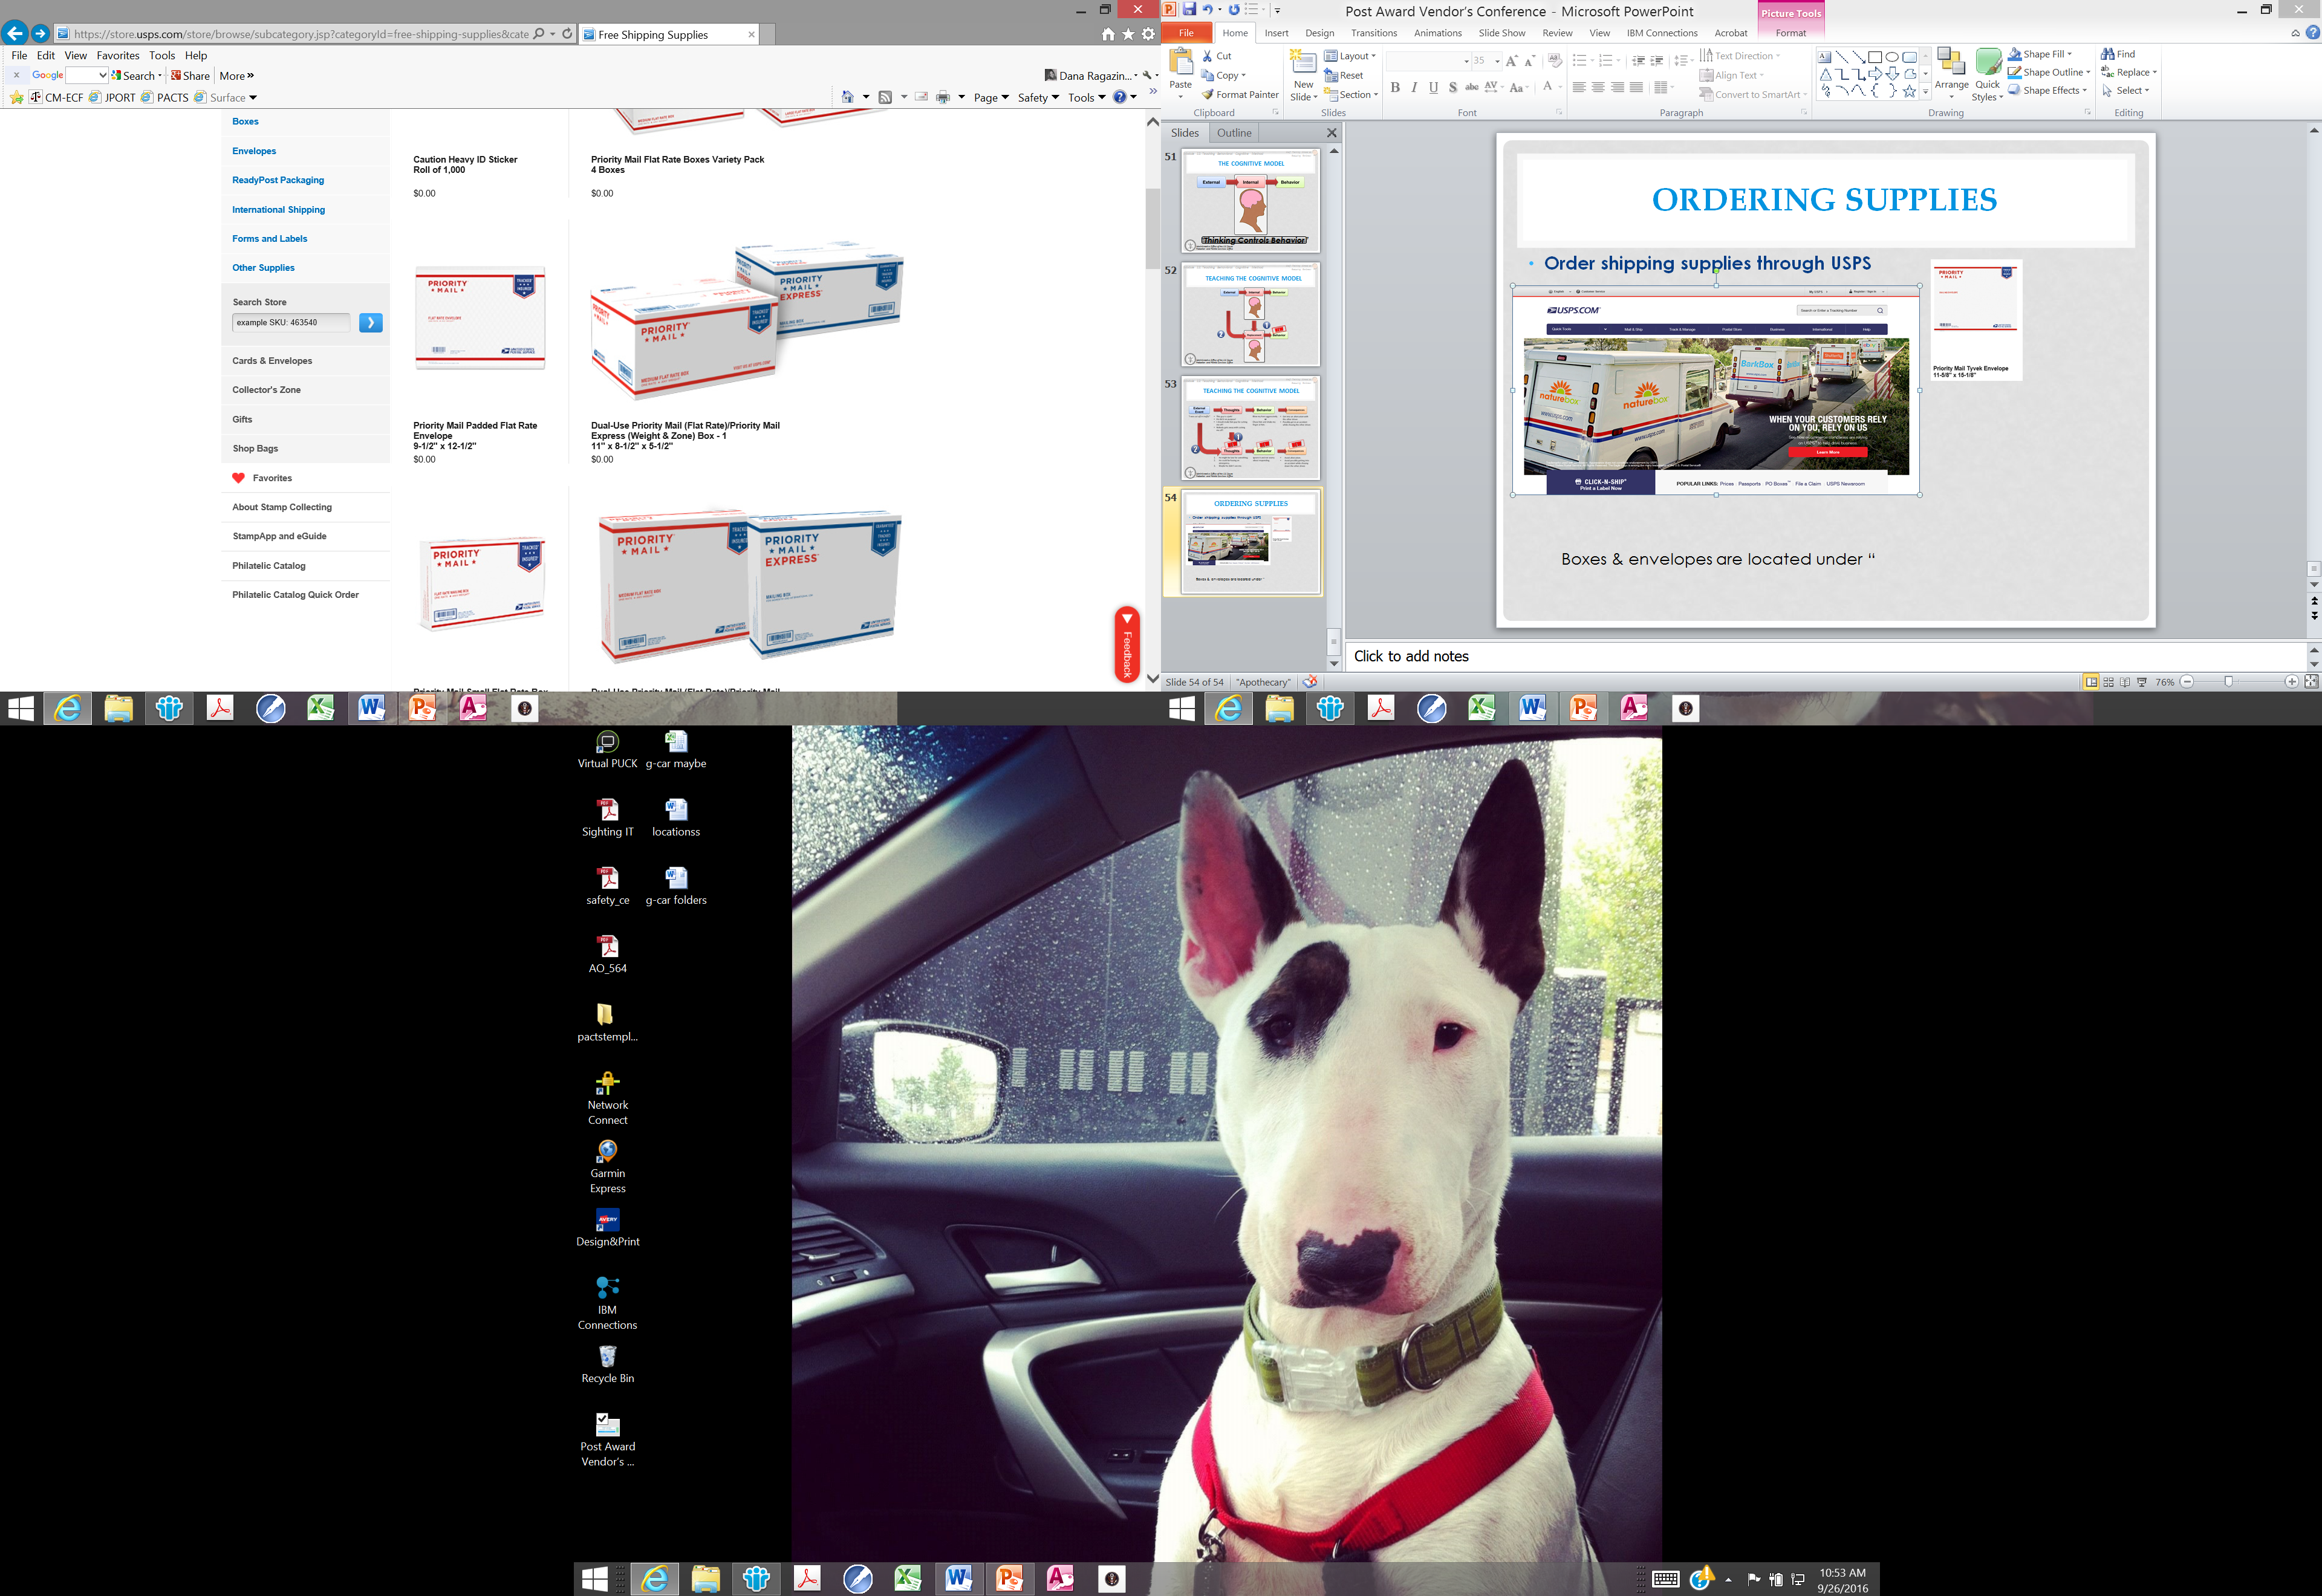
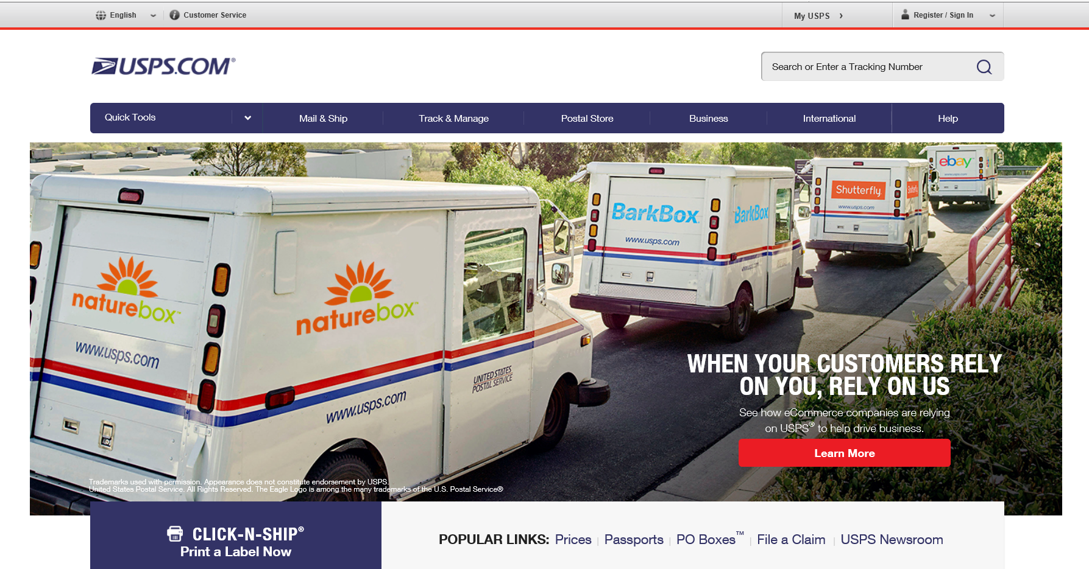

Ordering Supplies
Order shipping supplies through USPS
  USPS shipping bags & shipping boxes can be ordered through the United Sates Postal Service website under “Free Shipping Supplies.”
  Our office will no longer supply USPS shipping bag & boxes.

Slide 52
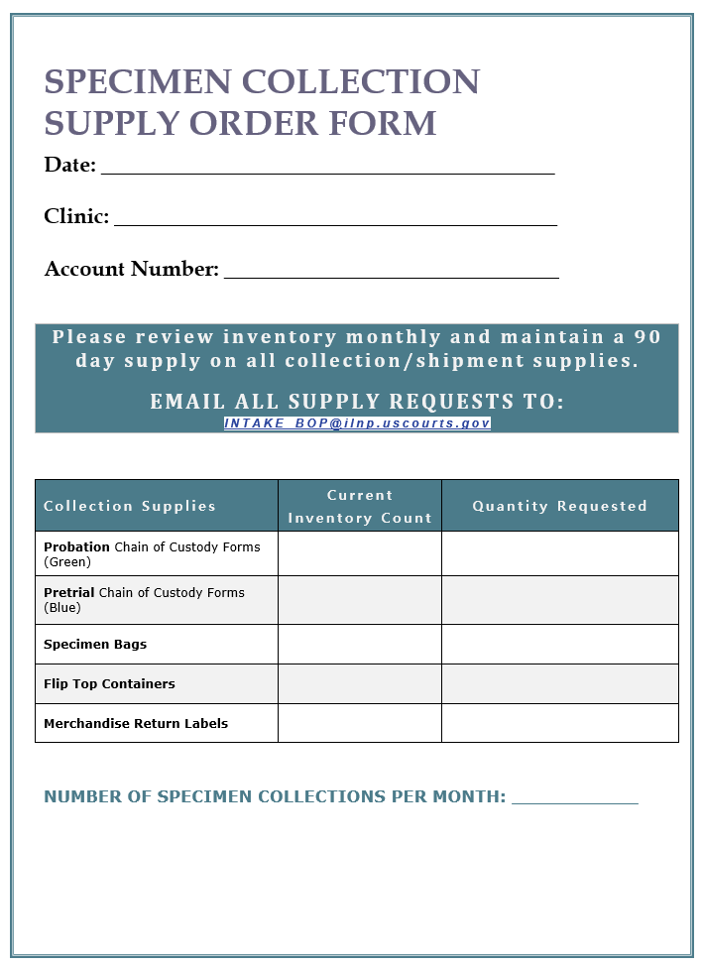
Ordering Supplies
Ordering supplies from the U.S. Probation Office
Probation Chain of Custody Forms (Green)
Pretrial Chain of Custody Forms (BLUE)
Specimen Bags
Flip Top Containers
Merchandise Return Labels

Slide 53
Important Final Notes:
Each agency needs to provide a list to us each year of any and all scheduled days for closure, for instance holidays, institute days, etc.
If you are not receiving emails with the list of who is coming in for a urine screen, please check your trash and/or junk mail folder first.
For any last minute/emergency closures (weather related, building maintenance related, etc.) or any trouble shooting with Comply please email INTAKE_BOP@ILNP.USCOURTS.GOV (same email used for supply ordering)

Slide 54

U.S. Pretrial Services
219 S. Dearborn Street
Room 15100
Chicago IL, 60604
Phone: (312) 435-5793
Fax: (312) 435- 5545
U.S. Probation
230 S. Dearborn Street
Suite 3400
Chicago, IL 60604
Phone: (312) 435-5700
Fax: (312) 408-5061

Slide 55




Questions

Slide 56


